Slide 1
Till Death Do Us Part!
How can we have a lasting relationship with our retirement savings?
10 September 2018
Shri Rengasamy, FIA
DC Innovation Leader
London - Tower Place
This talk reflects the speaker’s own views , and not necessarily those of Mercer, any affiliated company of Marsh & McLennan Companies, or any of their offices, directors or employees or of any of the other organisations referenced in this talk.

Slide 2




Till Death Do Us Part!
It’s not the same challenge everywhere
Large
Legacy DB
With
Growing
DC
Large
Legacy DB
With
Sizeable
DC
Largely DC
DB = Defined benefit / final salary, where a known amount, typically based on pre-retirement salary and income, is paid from retirement to death
DC = defined contribution, where benefits are based on contributions and investment returns (net of charges)

Slide 3
Till Death Do Us Part!
Retirement planning myths vs. Realities
Retirees are all the same – a “one size fits all” works well
Retirees, like active participants, are disengaged
In retirement all retirees need is an inflation-linked income, income is a retiree’s focus
Expenditure reduces as people approach retirement as debt levels reduce
Retirees are not all the same – they have diverse needs and require diverse solutions
At retirement, retirees do take the time – they will engage if it is something they believe they can engage with
Retirees income needs typically decline into retirement, and asset preservation seems very important
The incidence of debt amongst those aged over 55 in the US has significantly increased since 1992; over 2 in 5 of US retirees hold at least one form of debt*
*Source: Employee Benefit Research Institute
Notes:
Other myths can be things like property – not everyone has a property at retirement and it will be less in the future also; and DB – common misconception that everyone retiring has DB savings.
Retirees Are Resilient
At least ¾ manage within their reduced financial constraints
Some events are more significant in effect (e.g. divorce, long-term care expenses)
Some retirees provide longer term support to children or grandchildren at the detriment of their own retirement security
Source: Carol Bogosian (SOA) presentation to DCIIA at 2017 Academic Forum
The Employee Benefit Research Institute (EBRI) undertook a study examining the extent to which the non-housing assets of certain retirees changed during their first 20 years of retirement (or until death, if earlier).
The study shows that retirees generally exhibit very slow decumulation of assets.
While some retirees do spend down most of their assets in the first eighteen years following retirement, about one-third of all sampled retirees had increased their assets over that period.
44% of US retirees surveyed hold at least one form of debt (in decreasing amounts of paid-up hierarchy: credit card, mortgage, medical, education)
35% of US retirees end up carrying mortgage debt into retirement (29% <$50k, 71% >$50k) vs 69% of US participants expect to pay off mortgage before retirement
Employee Benefit Research Institute published a study on debt patterns amongst the elderly (over 75) and those approaching that age. The figures covered the period from 1992 to 2016 and were based on the Federal Reserve’s triennial survey on family wealth (‘Survey of Consumer Finances’). Key findings were:
The incidence of debt amongst aged over 55 in the US has significantly increased since 1992. This compares to broadly no noticeable change in the incidence of debt amongst those aged 55 and younger.
Older families as well as lower income families have seen increased debt payments, more so than other groups in the study.
Worryingly, the percentage of those who have debt problems (defined as debt repayments being more than 40% of income) has only increased amongst those over 75 since 2007. All other ages groups have seen a reduction in the percentage of those with debt problems over the same period.
The overall trends in debt have been driven by housing debt since 2001.
Those over 55 are not necessarily only focussed on wealth management (accumulation/decumulation), but actually are grappling with debt.

Slide 4
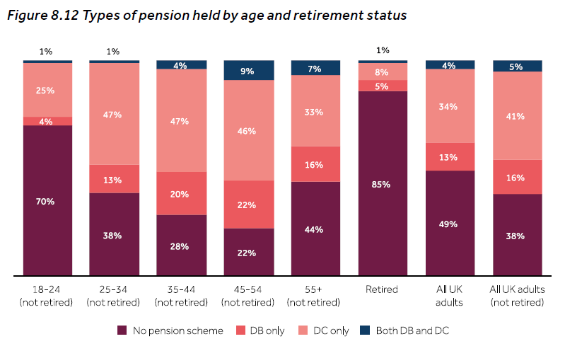
Till Death Do Us Part!
Changes in the pensions landscape
Reliance on Defined Contribution Pension Arrangements is set to increase
Source: FCA, Financial Lives Survey 2017.
Notes:
DB vs DC – a choice, cost and contributions
The proportion of pension scheme ownership drops amongst adults aged 55 and over who have not yet retired, among whom a significant minority (36%) have already accessed a pension.
Just one quarter (24%) of employees do not have a pension (which they have not accessed) – this compares to half (51%) of the self‑employed and three quarters (78%) of the unemployed.
The number of people accruing defined benefits (DB) is declining, primarily due to the increasing employer preference for offering defined contribution (DC) schemes and the closure of many DB arrangements.
For those younger than age 45, less than 20% are likely to have some form of DB benefit at retirement.
Unsurprisingly, this suggests that DC arrangements will become the primary source of income at retirement and people are less likely to have significant DB benefits elsewhere on which to rely.
A particular worry from this survey is the high proportion of people in each category with no pension savings at all.
Retirees whose main source of income in retirement is the State Pension are more likely to be female (53%) than male (33%).
Compared with retirees not relying on the State Pension in retirement, those who do so are:
more likely to be single (52% of retirees for whom the State Pension is their main source of income, compared with 33% of retirees not relying primarily on the State Pension)
more likely to have no savings or investments (40% compared with 15%, respectively)
less likely to own their own home outright (61% compared with 82%, respectively)
more likely to be renting (28% compared with 3%, respectively)
less likely to be satisfied with their overall financial circumstances (31% are highly satisfied, compared with 45% of retirees who do not rely primarily on the State Pension)

Slide 5


Till Death Do Us Part!
What are the key retirement challenges?
—
Forecasting longevity
—
—
WORKING
DIFFERENTLY
—
—
Care Costs
—
—
Cost of living
—
—
Gender pension gap
—
—
Health deterioration
—
Notes:
A 65 year-old couple retiring this year will need $275,000 top cover health care costs in retirement
1/3 od global retirees who retired earlier than expected did so due to personal/familial health concerns

Slide 6
Till Death Do Us Part!
What are the risks faced in retirement?
Initial income generation & costs | Longevity risk | Inflation risk
Insurer credit risk | Annuity conversion rate risk | Terms and conditions risk
Sequencing risk | Pound cost Averaging ravaging | Access to capital (wealth effect)

Slide 7



Till Death Do Us Part!
What income options are available at retirement?
Cash, cash and more cash | Lifetime Income products (e.g. annuity) | Drawdown (Invest and withdraw)
=Immediate | =Long-term | =Variable
Notes:
Elaborate on each option
Explain lifetime income products
Discuss investments used in drawdown, rates of return and lack of default

Slide 8
Till Death Do Us Part!
What are retirees doing?
Cash, cash and more cash | Lifetime Income products (e.g. annuity) | Drawdown (Invest and withdraw)
=Immediate | =Long-term | =Variable
54% | 13% | 33%
Source: FCA, Retirement Outcomes Review 2017, ABI (2016) and Pensions Policy Institute (May 2018).
Notes:
57% of pots are being withdrawn at a rate of <1%, 20% 1-1.99%, 13% 2-3.99%, 4% at >10%.
Around half of Australian retirees withdraw their savings as a lump sum.
Of these:
• 44% use it to pay off housing or other debts, to purchase a home, or to make home improvements.
• 28% use their lump sum to repay loans or to purchase a holiday or a new vehicle.
• The majority of those who do not choose to fully withdraw access their savings through an account-based system similar to drawdown:
• 94% of pension assets that are not withdrawn are held within these accounts.
• Around 5% of Australian pension assets that are not withdrawn are used to purchase an annuity.
• Hybrid products account for the remaining 1% of Australian pension assets.
Despite Swiss savers being permitted unlimited access to their private pension savings (though some schemes restrict access), annuitisation levels in Switzerland are high:
• Around 80% of DC assets are put into lifetime annuities.
However, Swiss annuity rates (which are regulated by the Government) are considered to be very generous given current low interest rates in the Swiss market and low mortality rates among annuitants.

Slide 9
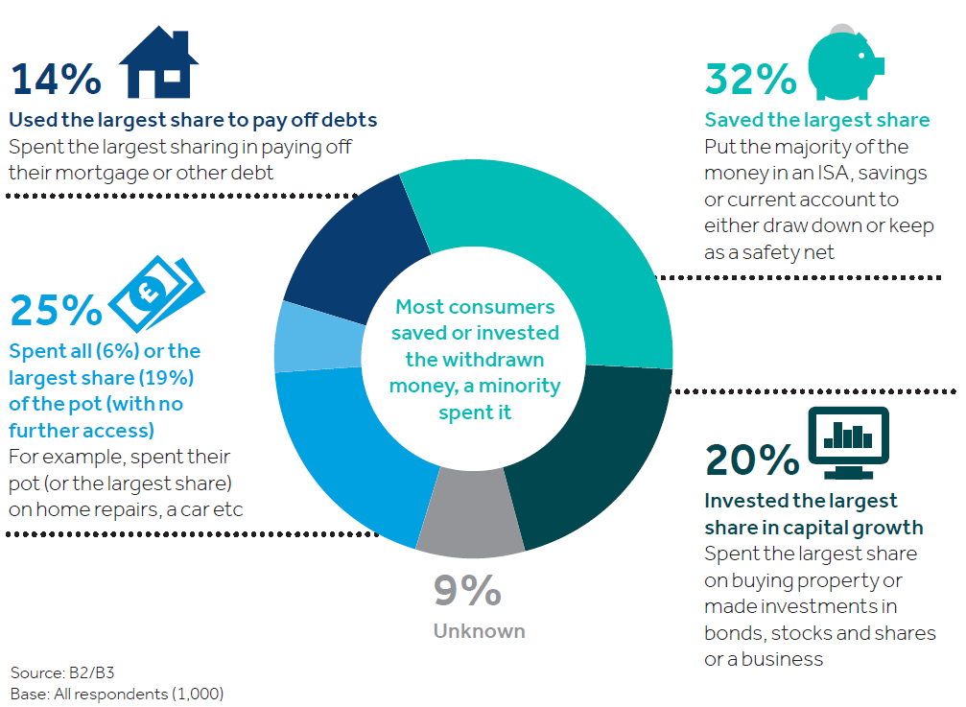
Till Death Do Us Part!
Where is the cash going?
Source: FCA, Retirement Outcomes Review 2017, ABI (2016) and Pensions Policy Institute (May 2018).

Slide 10
Till Death Do Us Part!
Prioritising “Essentials” in retirement
  Adequacy
  Sustainability
  Behavioural Finance
    Growth Seeking Investments
Extras
    Defensive Investments
Prioritise
certainty
Essentials
(e.g. eating & heating)
    Longevity Solutions
    State Pension
Age
Notes:
Key Messages:
Income Adequacy will be subjective to an extent although there is a base level of income (see “Essentials” in ‘Our Hierarchy of Needs’ chart later) that is necessary to allow people to live with dignity in retirement. Understanding more about that base level of income is important – particularly the potential for this level to change throughout retirement (Active, Passive, Frail phases).
Income Sustainability – naturally retirees want security that their ‘adequate’ income is going to last – becoming an increasing concern given improving life expectancy rates and introduction of pension flexibility (compulsory annuitisation removed the issue of sustainability although income adequacy clearly remained a problem). Income adequacy and sustainability are inextricably linked and should be considered in tandem when designing solutions for retirees.
Behavioural Finance – seeks to address the preferences and decision making process of individuals. As an industry, we might create the most innovative of solutions that, in our view, are in individuals’ best interest but unless they align with what people actually want, they are unlikely to receive broad-based support.
{Link to our personalised comms work and the behavioural science aspects of this}
Evidence (from mature DC markets) of hierarchical mindset being applied by retirees when thinking about their income needs and risk tolerance in retirement
Concept of “Essentials” and “Extras/Aspirational” aligns with how individuals think – solutions should be designed and communicated in this manner
Individuals will generally prioritise having enough for essentials (food, shelter) and will want greater certainty of not missing this base level objective – therefore more stable income sources are preferred.
If possible, retirees will simultaneously want to give themselves best chance of being able to afford extras (eating out, occasional holiday, etc) and will generally be willing to accept less certainty (ie greater range of possible outcomes) of achieving this goal.

Slide 11




Till Death Do Us Part!
What is currently available to help individuals?
Products
Costly and complex to navigate as well as ‘shop around’
Advice
Personalised and holistic, but expensive
Guidance
Not personal enough, rarely holistic and often not definitive
Tools
Abundance of calculators, planning/budgeting apps and modellers, but with varying degrees of precision, complexity and accessibility

Slide 12
Till Death do us part!
What can the industry and academia do to help?
Design solutions that improve
Personalisation
Accessibility
Simplicity
Security
Data science
Technology
Cost
Robo-advice
AI
Robo-management
Machine Learning
Trust-building initiatives
Notes:
Solutions that build back the trust? – why do people disinvest from the pension to reinvest it again?
Fees – do post retirement workplace solutions provide the better/value add solutions? Or is enough being done on retail solutions outside the workplace? Benchmarking and comparisons
Longevity assessments?
Tracking legacy pensions- fintechs - design
Cost of financial advice? Do the free services provide enough?
Effective communication

Slide 13
Mercer Limited is authorised and regulated by the
Financial Conduct Authority
Registered in England and Wales No. 984275
Registered Office: 1 Tower Place West, Tower Place, London EC3R 5BU

